Slide 1


Signature Platform
A Web-Based Contract System with Enforced
Multi-Method Identity Verification
Suhair Mohammed Fuad C2512032182
Mona Jihad Saeed Hashem B231906002
Amoon Mohammed Saleh Al-Jabli B231906011
Farah Iftikhar Dhia’a Al-Deen B231906012
Rehab Ahmed Mohammed C231905181
Maram Ahmed Bin Ahmed Abdul Majeed B231905146
Asrar Khaled Mohammed Saeed B231905143
Dr. Mohammed Bin Shahna

Slide 2


Abstract
The problem, and what this project does about it
The Problem
The Solution
Paper contracts depend on physical presence and ink. Once the parties leave the room, the only thing tying them to the agreement is a piece of paper that can be lost, copied, or denied.
Existing electronic services like DocuSign, Zoho Sign, and eSignatures.com solve part of the problem, but they collapse the proof of agreement into a single click — rarely enough when the agreement is later disputed.
A web-based contract platform that enforces multi-method identity verification on every party before a contract is sealed. Built with PHP 8.1 and MySQL 8.
The creator drafts a contract, invites parties by email, and chooses any combination of eight verification methods. When every party has signed, the system computes a SHA-256 hash, exports a PDF, and produces a QR code linking to a public verification page.

Slide 3
Problem Statement
Why a single click is not enough
1
Paper is physical
Easy to lose, hard to verify after the fact, no remote signing.
2
A click is weak proof
Existing services compress the proof of agreement into one click. When disputes happen, the trail comes down to a 'link opened' email.
3
Cost and language gaps
Per-document pricing is high for small businesses. Most international platforms treat Arabic and right-to-left content as an afterthought.

Slide 4







Objectives
What the platform must do
PHP/MySQL platform
Eight verification methods
Draft, send, and track contracts between two or more parties.
Mix and match the proof level per contract.
Block until passed
Immutable audit trail
Skipping a method cannot move the party forward.
Every event with timestamp, IP, and user agent.
SHA-256 + QR verification
Evidence pack
Hash on finalize; QR points to a public verification page.
Single ZIP with PDF, raw files, and manifest.
Arabic & RTL native
Self-hostable
Both UI and PDF, not bolted on later.
Plain PHP/MySQL hosting or local XAMPP — no paid services.

Slide 5
How It Compares
Signature Platform vs incumbent e-sign services
Feature | DocuSign | Zoho Sign | eSignatures.com | Signature Platform
Verification methods | 1 + paid add-ons | 1-2 (OTP) | 1 (click) | Up to 8, mix & match
Live selfie at sign time | Add-on | No | No | Built-in
ID document upload | Add-on | No | No | Built-in
Video consent recording | No | No | No | Yes
Self-hosted | No | No | No | Yes
Arabic / RTL support | Limited | Partial | No | First-class
QR public verification | No | Limited | No | Yes
Cost for individuals | High | Medium | Low | Free (self-host)

Slide 6
Methodology
Incremental SDLC over four releases
The team chose the Incremental model: features split into independent slices, each ending in a working, testable system. This let the supervisor react early to the verification UX — the most novel part of the project — without waiting for the final release.
1
2
3
4
Increment 1
Increment 2
Increment 3
Increment 4
Foundation
Invite & Reject
Six More Methods
Finalize & Verify
Authentication, dashboard, draft creation, and a single signature method.
HMAC-signed tokens, rejection flow, and uploaded signature images.
Selfie, ID, OTP, consent, geo, and video — plus the per-contract picker.
mPDF export, audit table, SHA-256 hash, QR code, public verification.

Slide 7
System Architecture
Classic three-tier layout, self-hostable
CLIENT TIER
APPLICATION TIER
DATA TIER
Browser
Apache + PHP 8.1
MySQL 8 + Files
Quill 2.x rich-text editor
HTML canvas signature pad
Webcam + MediaRecorder
Vanilla JS — no framework
Routing, CSRF, auth
Rate limiting
File storage outside webroot
Eight verification handlers
Relational data: 11 tables
Storage volume for uploads
Audit trail (immutable)
Schema in db/schema.sql
HTTP / JSON
PDO / SQL

Slide 8
Technology Stack
Plain PHP — no heavyweight framework
PHP 8.1
MySQL 8
mPDF 8.x
SERVER
DATABASE
PDF
All backend logic, routing, templating
Users, contracts, parties, audit, JSON payloads
Renders the final PDF with Arabic & RTL support
PHPMailer 6.x
endroid/qr-code
Quill 2.x
MAIL
QR
EDITOR
Invite emails and OTP through SMTP
Pure PHP QR generation, no external service
Rich-text contract body with RTL toolbar
MediaRecorder
Canvas API
Apache 2.4
BROWSER API
BROWSER API
WEB SERVER
Records video consent in webm
Captures the drawn signature
XAMPP locally, standard hosting in production

Slide 9








Eight Verification Methods
Configurable per contract — combine any subset
Drawn Signature
Signature Image
Live Selfie
ID Document
HTML canvas, exported as PNG
PNG/JPG upload, max 2 MB
Webcam capture at sign time
Front + optional back upload
Email OTP
Typed Consent
Geolocation + IP
Video Consent
6-digit code, rate-limited
Match a fixed phrase exactly
Browser geo + server IP capture
Up to 30s via MediaRecorder

Slide 10
Data Model
Eleven tables — contract, parties, requirements, submissions, audit
Each table earns its weight — the separation between requirements (what was asked) and submissions (what was delivered) is what makes the audit trail hold up under dispute.
Columns per table
Key design decisions
Requirement vs submission
Two separate tables — what was asked, what was delivered.
Files outside webroot
Served through a controller with permission checks.
HMAC invite tokens
Stored as SHA-256 hashes in the DB, not raw tokens.
Immutable audit
Every event with timestamp, IP, user agent.

Slide 11
The Signing Flow
What happens between an invite link and a sealed PDF
Each step blocks until it passes. The audit table records every action with timestamp, IP, and user agent.
01
02
03
04
05
06
Invite
Open
Steps
Sign
Hash
Seal
HMAC token,
14-day expiry
Validate,
show contract
Required
verifications
All passed,
party marked signed
SHA-256 over
locked content
PDF + QR +
public verify page

Slide 12
Requirements Snapshot
21 functional and 10 non-functional requirements
21
10
8
11
Functional
Non-functional
Methods
Tables
What the system does
How well it does it
Verification options
Relational schema
Functional highlights
Non-functional highlights
FR-04 Tokenized invite links, HMAC-signed, 14-day expiry
FR-14 Block progress until every required method has passed
FR-17 SHA-256 of locked content when the last party signs
FR-19 Public verification page that recomputes the hash
FR-20 Evidence pack: PDF, raw files, manifest as a single ZIP
NFR-01 Bcrypt password hashing via PHP password_hash
NFR-03 All uploads stored outside the webroot
NFR-05 Pages render within 1 second on typical hosting
NFR-07 Keyboard and screen-reader reachable
NFR-09 Full Arabic and right-to-left support, UI and PDF

Slide 13
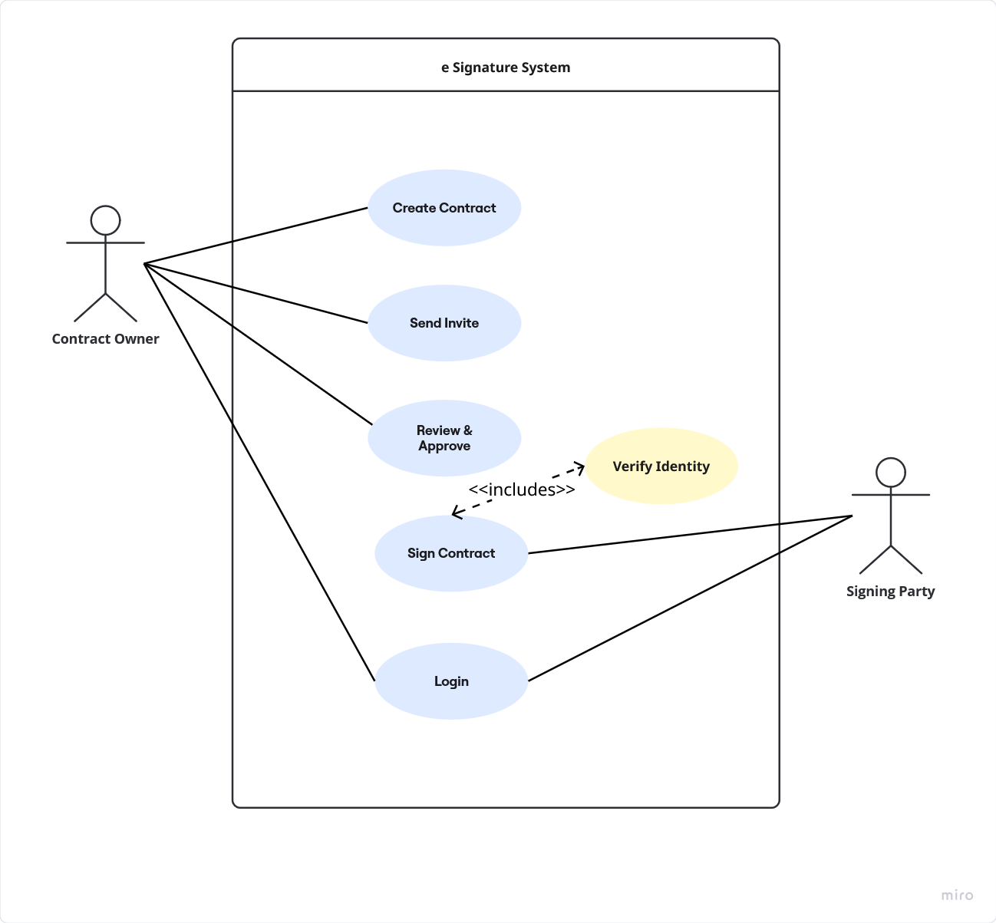
Use Case Diagram

Slide 14
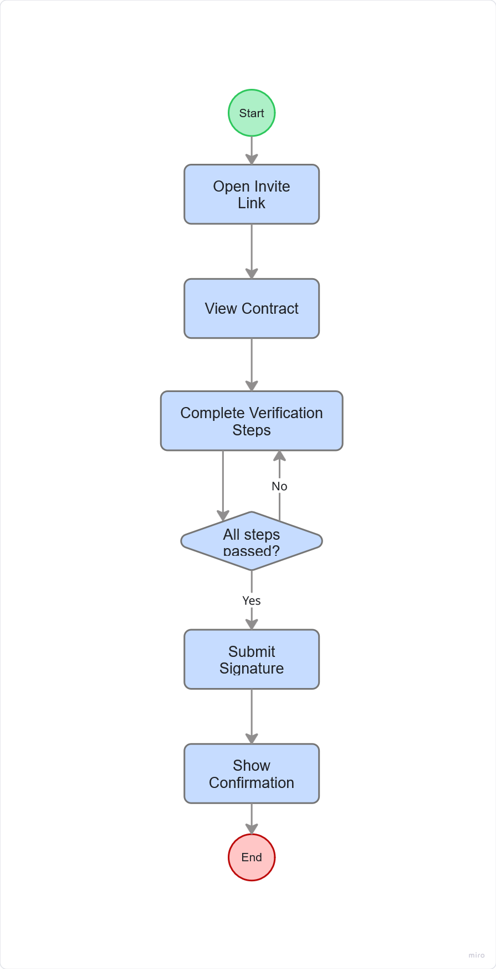
Activity Diagram

Slide 15
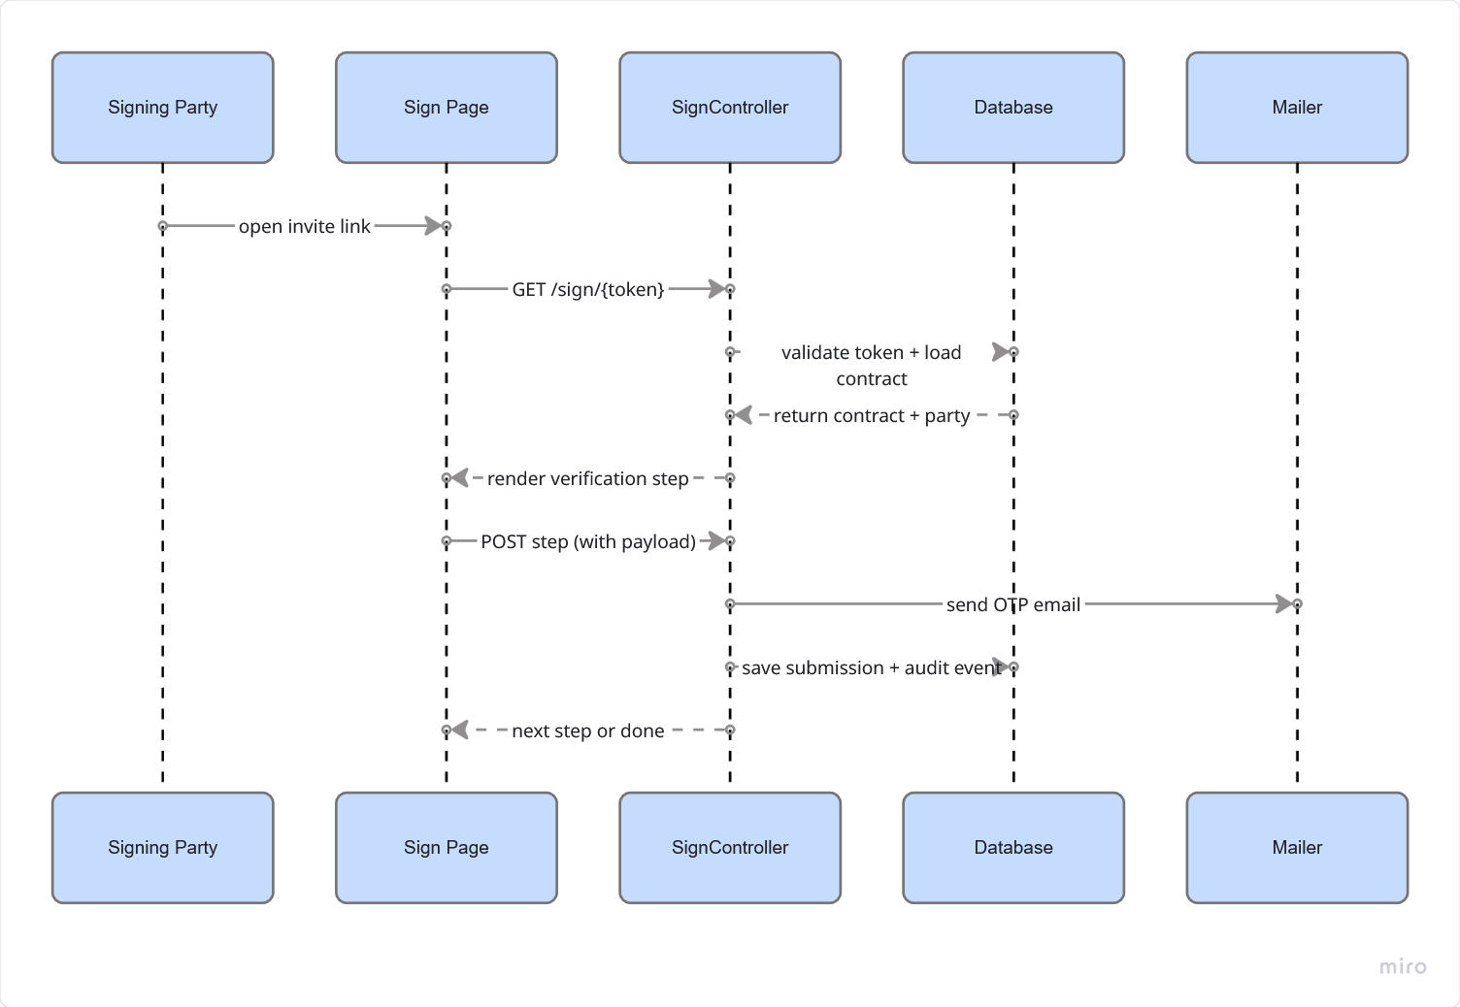
Sequence Diagram

Slide 16
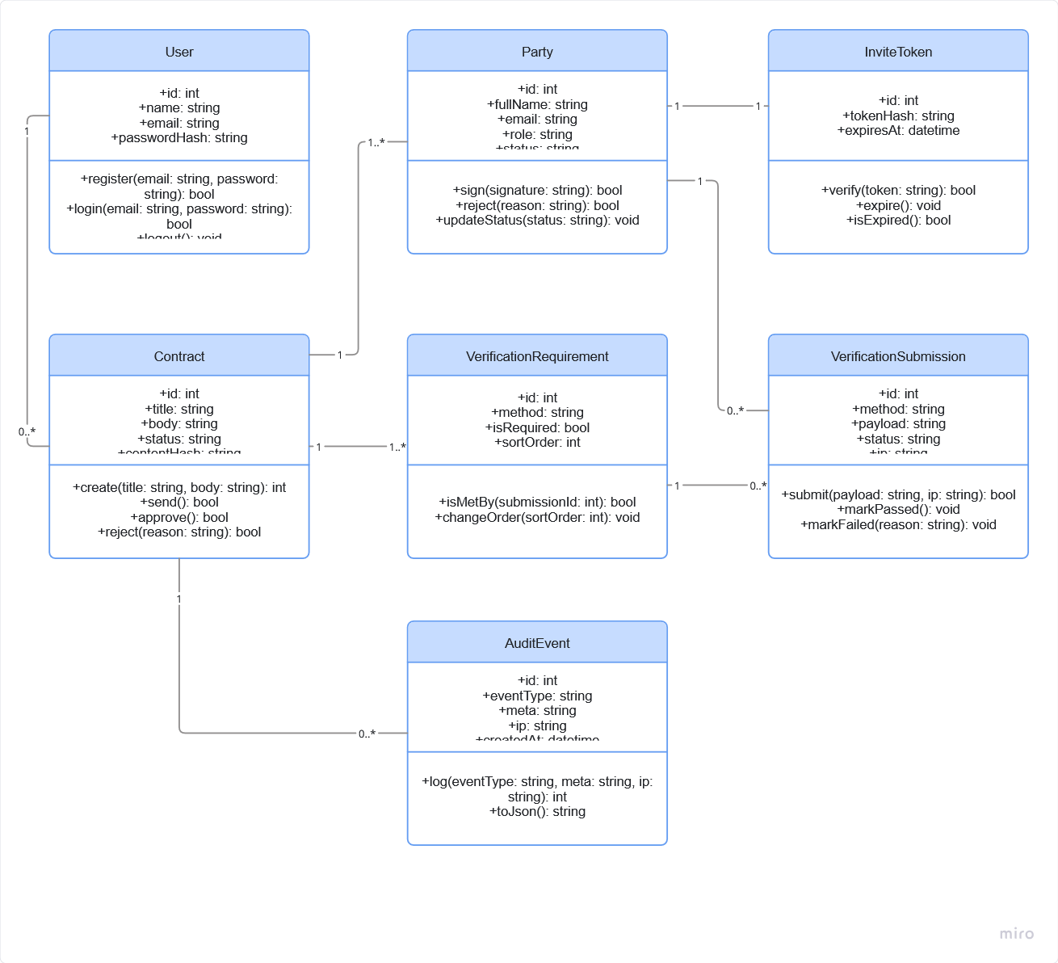
Class Diagram

Slide 17
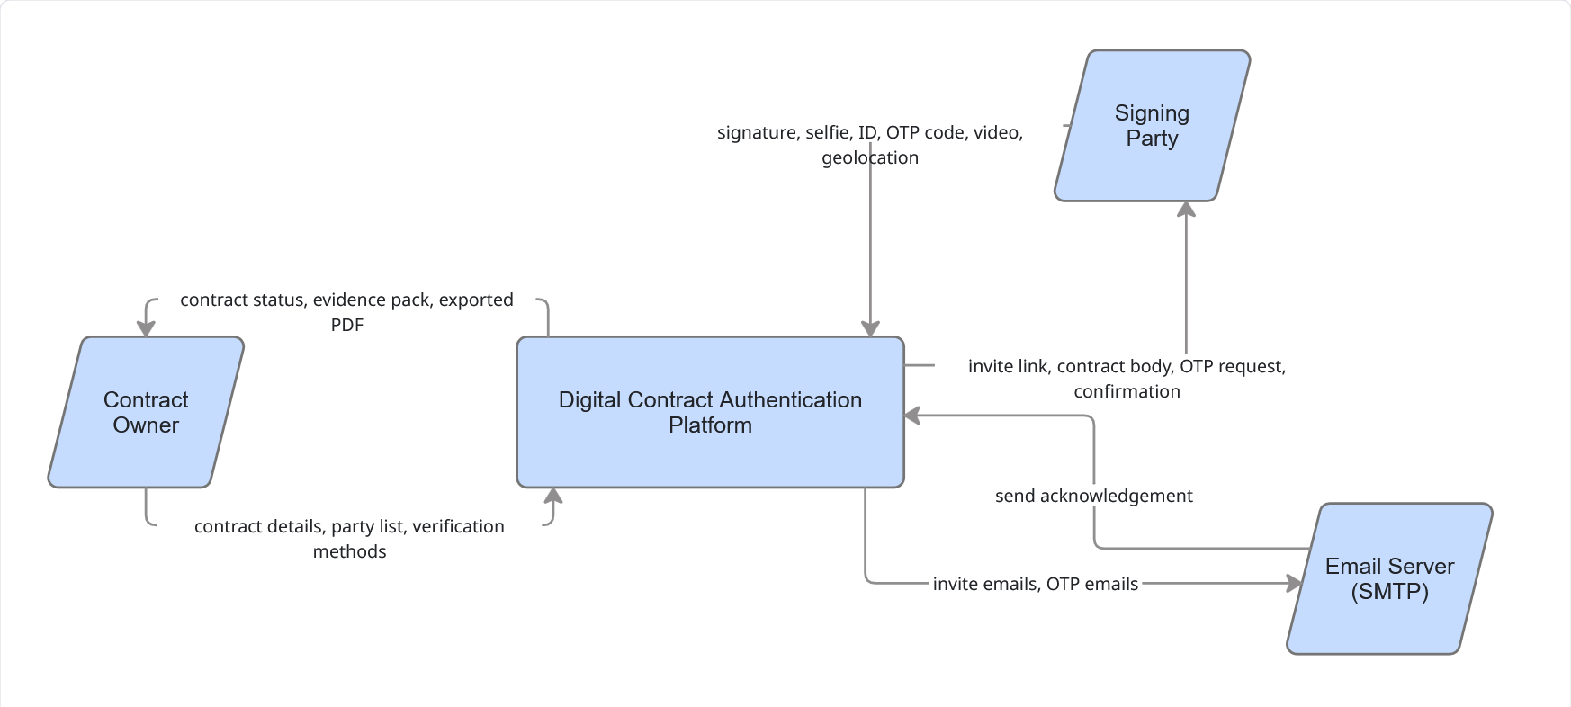
DFD

Slide 18
DFD

Slide 19
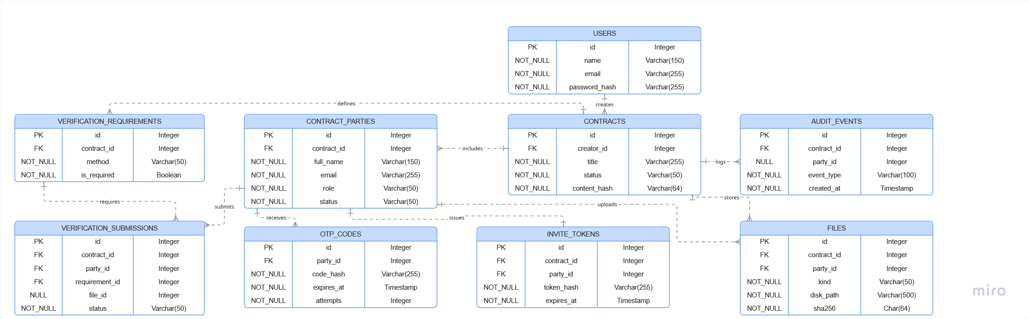
Database

Slide 20
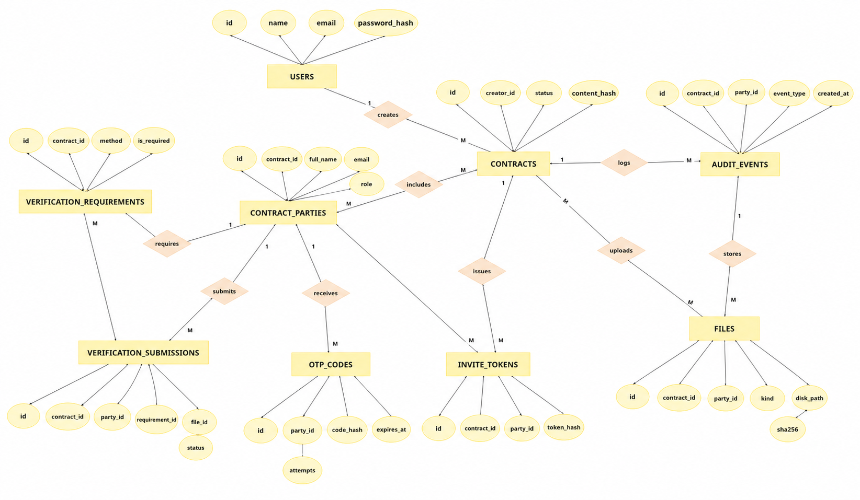
ERD

Slide 21
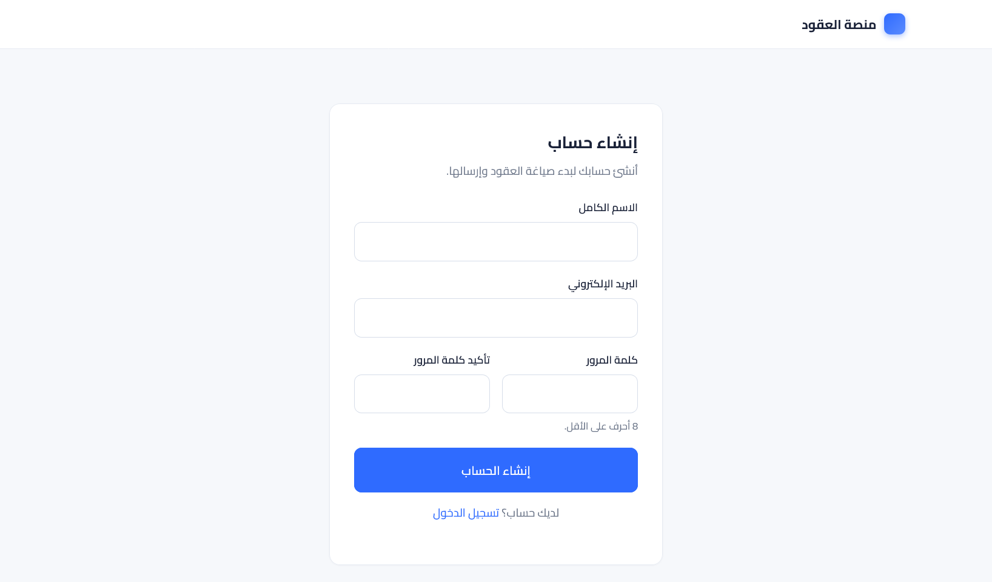
Authentication

Slide 22
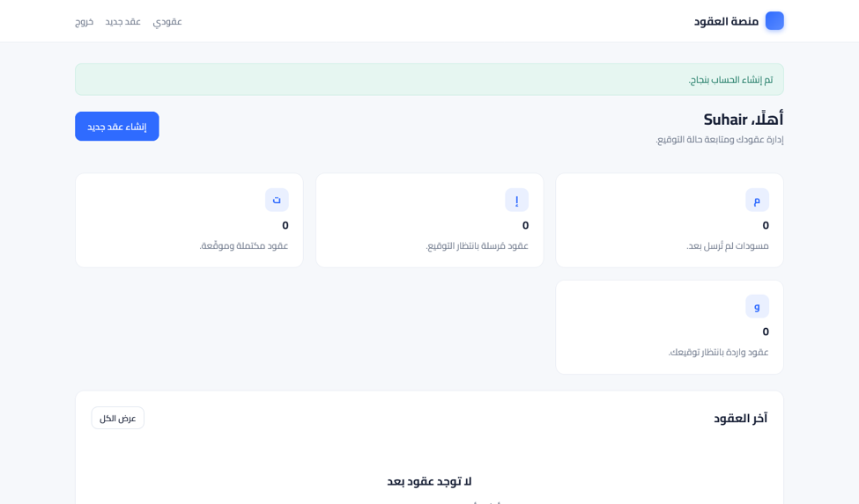
Dashboard

Slide 23
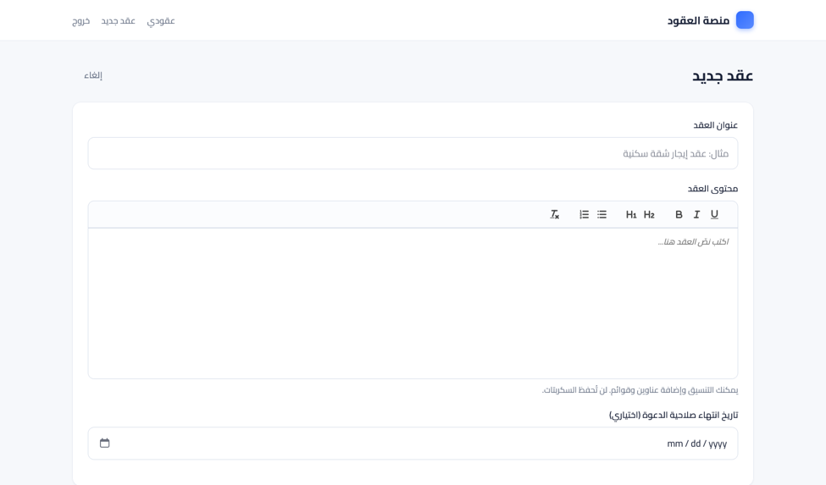
Contract Editor

Slide 24
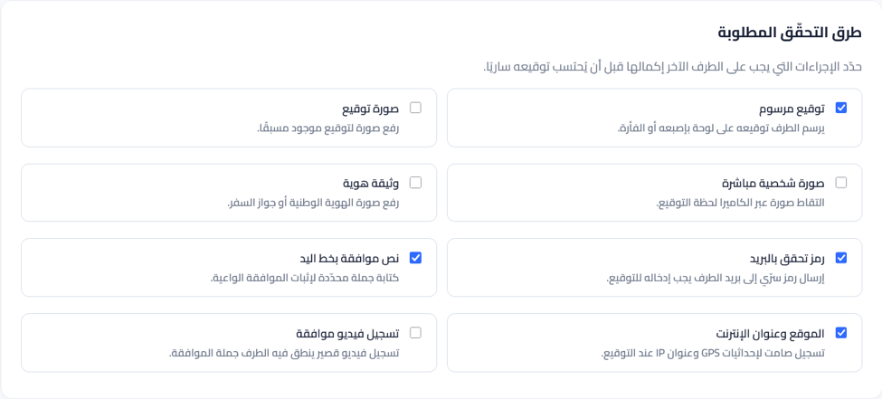
Contract Methods

Slide 25
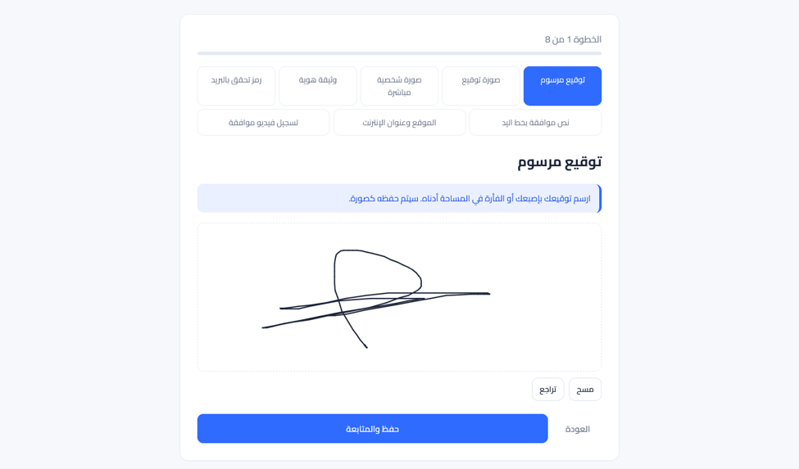
Sign Verification

Slide 26
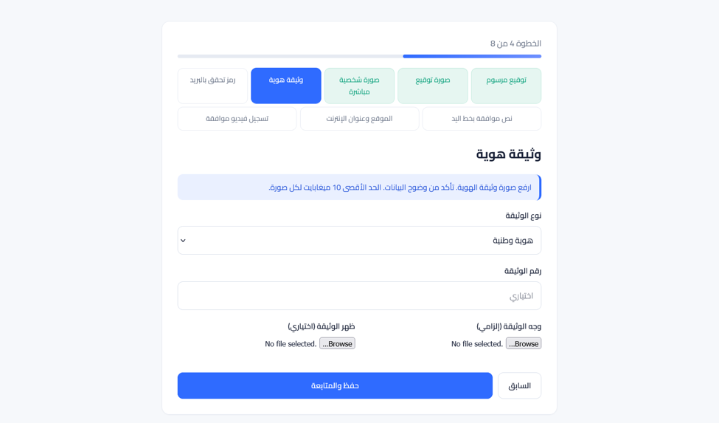
ID Verification

Slide 27
Future Work
Where the platform can go next
SMS OTP
Encryption at rest
Local-provider SMS in addition to email.
Per-contract data encryption key for stored ID and video.
OCR on ID documents
Liveness detection
Extract name and number, match to the party record.
Block printed photos and screen replays on the selfie step.
National ID federation
Blockchain anchoring
Bind to government digital identity providers.
Optional public timestamping of the SHA-256 hash.
Multi-tenant mode
Mobile-first redesign
One deployment serving many organisations.
Stepper rebuilt for small screens and patchy connectivity.
Headless integration tests
Template marketplace
Lock the verification flow against regressions.
Common contracts where creators only fill the variables.

Slide 28
Thank you

